Slide 1
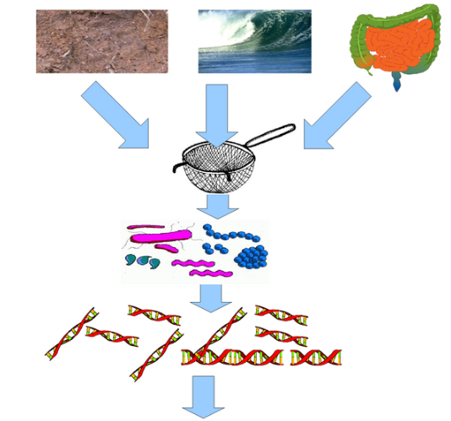

Metagenomic data analysis
In a typical genome project you want to sequence DNA from a single organism
Metagenomic data is sequenced from a sample intentionally containing many species (many of them unknown)
Important for studying composition of microorganisms (bacteria of fungus), diagnostics of diseases
https://www.neurology.org/doi/10.1212/NXI.0000000000000251

Slide 2
Characteristics of metagenomic data
Typically short reads (Illumina)
Number of species: unknown
Coverage of each species: unknown
Assembly possible? Maybe, but similar species can assemble together forming chimeric contigs
Preferred mode of analysis: K-mers

Slide 3
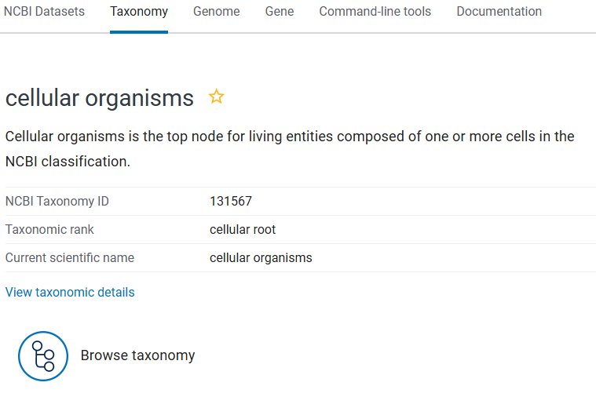
NCBI Taxonomy
The Taxonomy Database is a curated classification and nomenclature for all organisms in the public sequence databases.
This currently represents about 10% of the described species of life on the planet.
These species are part of NCBI Taxonomy tree. Each node on the tree has a numerical ID.

Slide 4
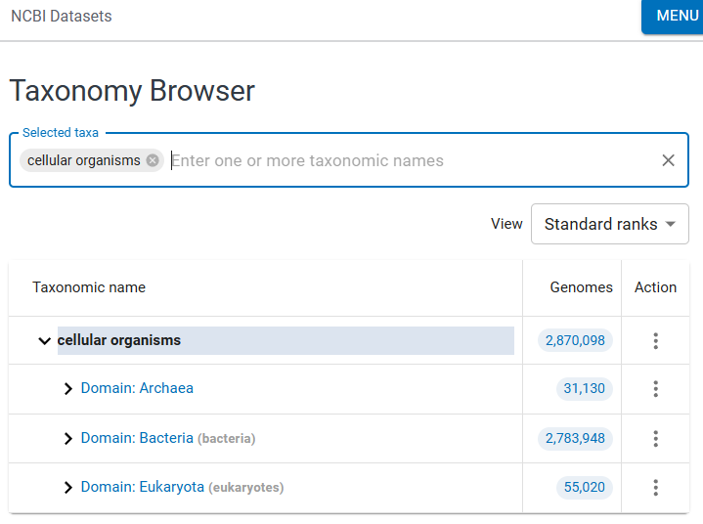
NCBI Taxonomy Browser
By browsing the taxonomy tree one can find all known species, their ID and known evolutionary relationships
DEMO

Slide 5
Analysis of metagenomic data
High resolution: KrakenUniq:
  Build database of all k-mers in a set of species to be classified
  Attach Taxonomic ID to each K-mer
    Use the lowest common ancestor’s ID
  Examine all k-mers in reads from metagenomic sample
  Determine what Tax IDs are present
Databases are BIG!

Slide 6
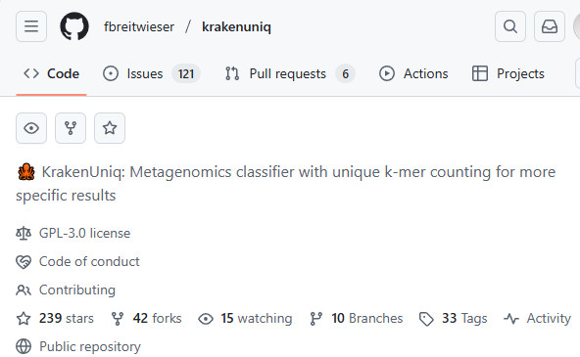
Analysis of metagenomic data
High resolution: KrakenUniq:
  Build database of all k-mers in a set of species to be classified
  Attach Taxonomic ID to each K-mer
    Use the lowest common ancestor’s ID
  Examine all k-mers in reads from metagenomic sample
  Determine what Tax IDs are present
Databases are BIG!

Slide 7


Why Uniq in KrakenUniq?
NOT IN the sample due to repeat or contamination
IN the sample
Species 1
Species 2

